Slide 1

RESTAURANTS RATING PREDICTION
MACHINE LEARNING PROJECT
TEAM MEMBERS: NITHISH BABU, AKHIL VYDYULA, SUDIKSHA PATIL,

Slide 2
Business Problem
1.Problem Description
Restaurants from all over the world can be found here in Bengaluru. From United States to Japan, Russia to Antarctica, you get all type of cuisines here. Delivery, Dine-out, Pubs, Bars, Drinks, Buffet, Desserts you name it and Bengaluru has it. Bengaluru is best place for foodies. The number of restaurant is increasing day by day. Currently which stands at approximately 12,000 restaurants. With such a high number of restaurants. And new restaurants are opening every day. However, it has become difficult for them to compete with already established restaurants. This Zomato data aims at analyzing the demography of the location.
Most importantly it will help new restaurants in deciding their theme, menus, cuisine, cost etc for a particular location.
It also aims at finding similarities between neighborhoods of Bengaluru on the basis of food.
- Does demography of area matters? - Does location of particular type of restaurant depends on people living in that area> - Are any neighborhood on similar based on the type of food? - Is particular neighbors is famous for its own kind of food? - What kind of food is famous in locality?

Slide 3
Problem Statement
The dataset also contains reviews for each of the restaurants which will help in finding an overall rating for the place. So we will try to predict rating for a particular restaurant.
Real-world/Business Objectives
We need to predict rating based on different parameters like Average_cost for two people, Online Order available, foods, menu list, most liked dishes etc... features.
Machine Learning Formulation
Here we suppose to predict rating of a restaurant, so it is basically a Regression problem.
Performance Metric
We will try to reduce Mean Square Error i.e MSE as minimum as possible. So it is a Regression problem reducing MSE. -Ideal MSE is 0.

Slide 4
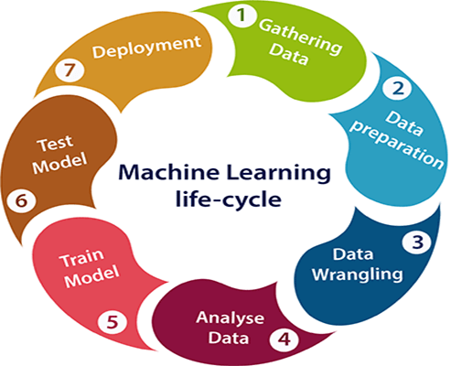
STEPS:
STRATEGY: Fixing the problem with accurate solution
Dataset preparation and preparation and preprocessing
Data collection
Data visualization
Data cleaning
Data preprocessing
Data transformation
3. Dataset splitting
4. Modelling
5. Model deployment

Slide 5
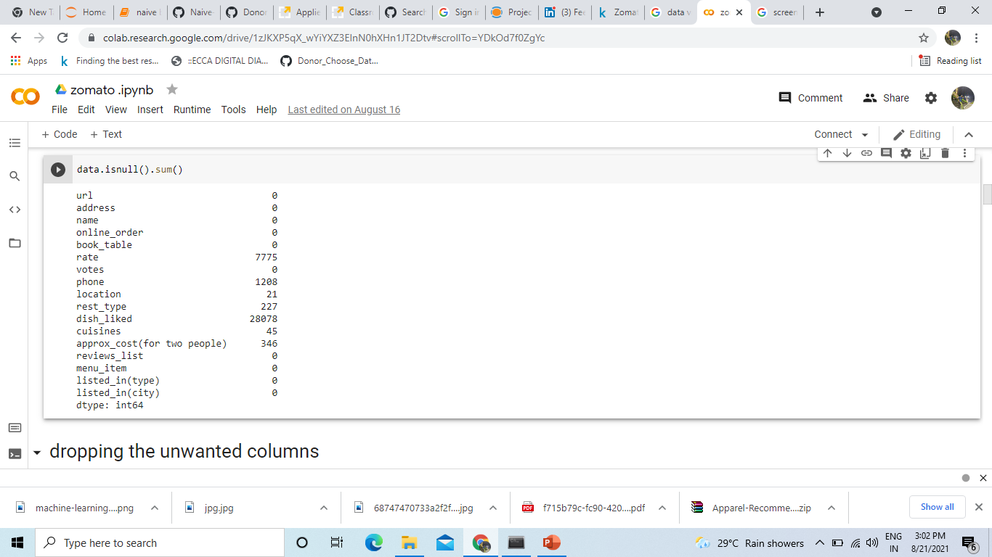
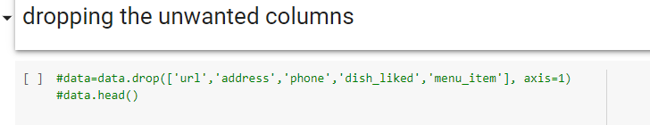
Data visualization:
Every machine learning problem solving starts with EDA.
It is probably one of the most important part of a machine learning project
In this project also we have clearly visualized all the features.
Data cleaning:
It is all about cleaning, removing, and removing null values, etc………
This dataset contains null values as show below
And those unwanted columns are removed as shown below.

Slide 6
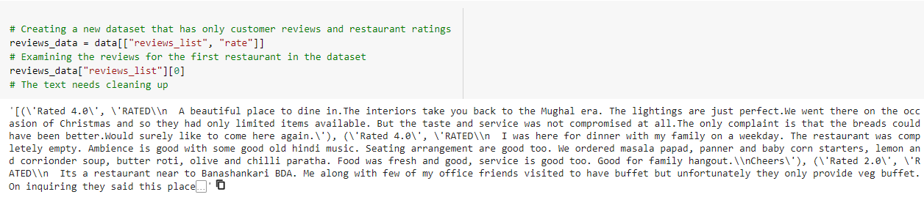
DATA PREPROCESSING
.
-Remove Duplicate values
-Remove Null Values
We observed that in ‘dish_liked’ 48.22% data is missing. Similarly in ‘Rate’ column, 10.22% data is missing. If we directly throw all NULL data out, we have to ignore 48.22% of original data. Can we somehow fill the missing data?
we can have two approaches.
1. Filling the missing values with appropriate values then operate. 2. Throw all null values and then operate.

Slide 7
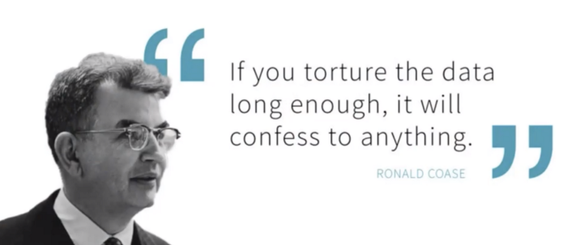
SPLIT DATA
Always remain we should first split data then apply featurization, to avoid data leakage problems. Divide data into Train, Test part.
DATA FEATURIZATION
We will convert all online_order’, ‘book_table’, ‘location’, ‘rest-type’ and ‘cuisines’ features into Categorical features. Then we will use one-hot encoding technique for featurization.

Slide 8
MODEL
we understand the data as well we visualize the data, now the actual machine learning part starts from here.
-After deep-diving into we can clearly say that ‘online_order’, ‘book_table’, ‘vote’, ‘location’, ‘rest-type’, ‘cuisines’ and ‘average_cost’ are important columns rest, we can drop other columns.
-‘Rate’ is output column
-First featurized review column with BOW, TFIDF, W2V and concatenated these other features and trained all the models with default parameters, the result was not so good.
Second considered only review column and featurized with BOW,TFIDF,W2V and trained all the models with each of these features.
Featurized with TFIDF and trained model.
Trained model with RandomForest Regressor and received MSE values of 0.014 and R2 score of 92.0406 which is good result. Hence finalized this model for deployment.

Slide 9
Q&A
Q1) What is the source of data?
The data for training is taken from Kaggle.
Q2) what was the type of data
The data is combination of numerical and categorical values.
Q3) what is the complete flow you followed in this project?
Refer above slides for better understanding.
Q4) What are the featurization techniques used in this Project?
Techniques used are BOW,TFIDF,W2V.
Q&A
Q1) What is the source of data?
The data for training is taken from Kaggle.
Q2) what was the type of data
The data is combination of numerical and categorical values.
Q3) what is the complete flow you followed in this project?
Refer above slides for better understanding.

Slide 10
Q&A
Q5) What techniques were you used for data pre-processing?
Removing unwanted attributes
visualizing relation of independent variables with each other
removing outliers
changing the data and imputing the null values
converting the categorical to numerical values
scaling the data
Q6) How prediction was done?
It’s a regression problem, so we performed some regressor algorithms, based on the customer review it will predict the rating.

Slide 11
Q&A
Q6) What is the final MSE value of model?
MSE=0.5
Q7) What if we didn't clean the data and pre processing?
It wont allow the tokenization, and its doesn’t perform model building.
Q8) How does each stats testes matters in model building?
We have performed hypothesis testing, chi sq tests. Which tells us how exactly distribution for each feature.
Q9) why do we need flask framework?
For small applications, we mostly use flask which is more reliable and flexible and easy to understand.
Q10) Do we get feature interpretability?
Yes, by observation of feature importance and we can conclude that which feature dominant for predicting rating.

Slide 12
Q&A
Q12) What are the future works to improve model?
There is always a scope of improvement. The remaining two models can be tuned for better results. For example, after plotting AUC in Logistic Regression we may get better results.

Slide 13
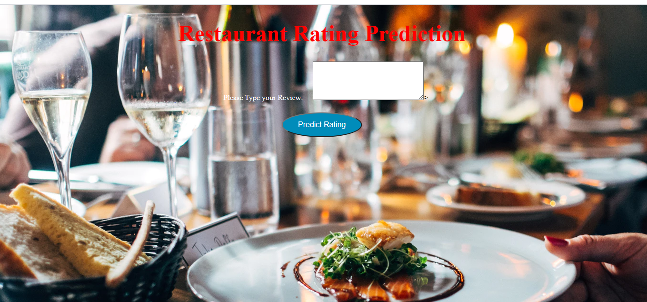
Created HTML page which includes a text field to type the review and a predict button to submit the review.
Once the predict button is clicked the predicted rating will appear in same page.
We have used Flask API and finally it is deployed in Heroku Platform.
Heroku is a platform as service that enables developers to build, run, and operate applications entirely in the cloud.
-

Slide 14

WEB PAGE AFTER DEPLOYMENT

Slide 15
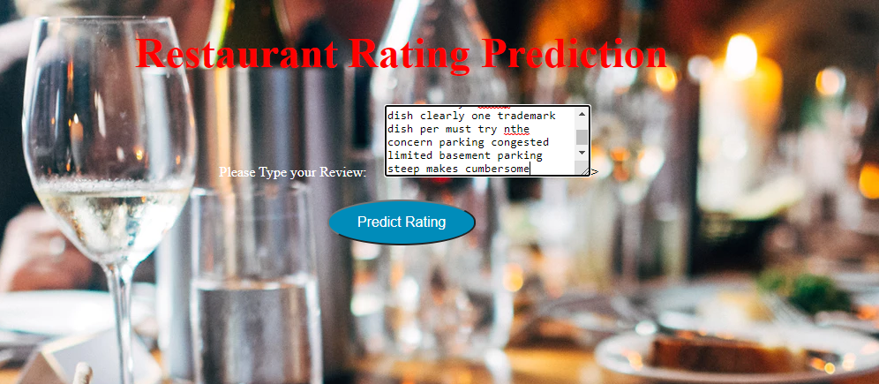
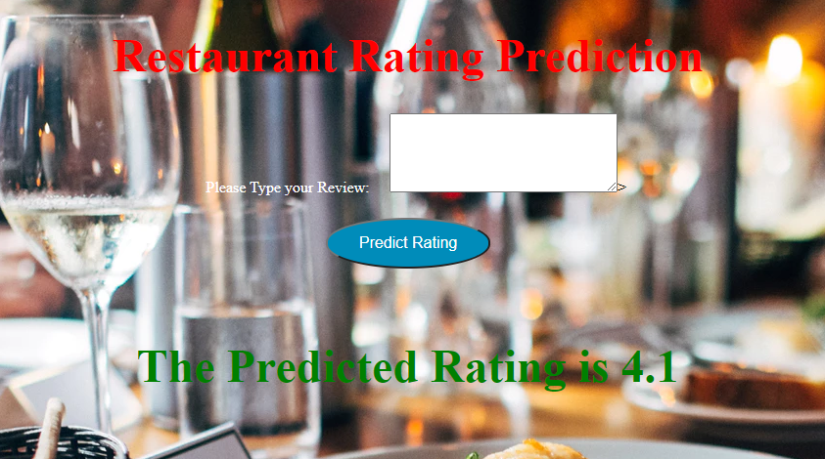
***Positive Review***

Slide 16

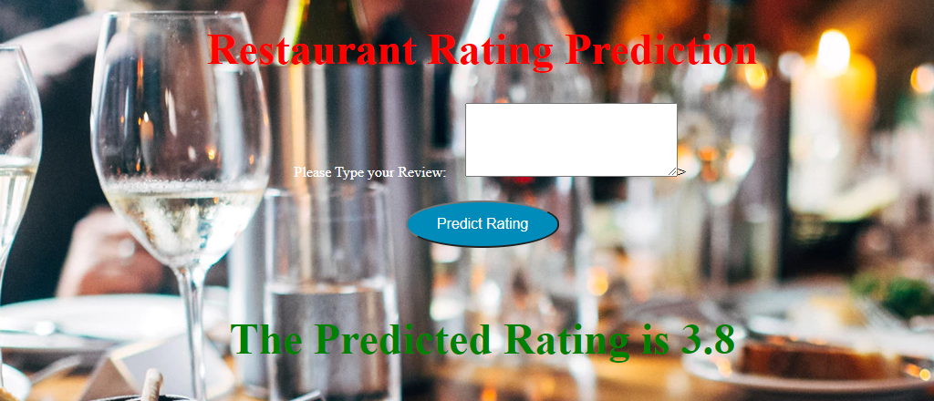
Negative Review

Slide 17
CONCLUSION
In this a number of features about existing restaurants of different areas in a city and analyses them to predict rating of the restaurant. This makes it an important aspect to be considered, before making a dining decision. Such analysis is essential part of planning before establishing a venture like that of a restaurant. Lot of researches have been made on factors which affect sales and market in restaurant industry. Various dine-scape factors have been analysed to improve customer satisfaction levels. If the data for other cities is also collected, such predictions could be made for accurate and more helpful.
*** THANK YOU***

